Slide 1
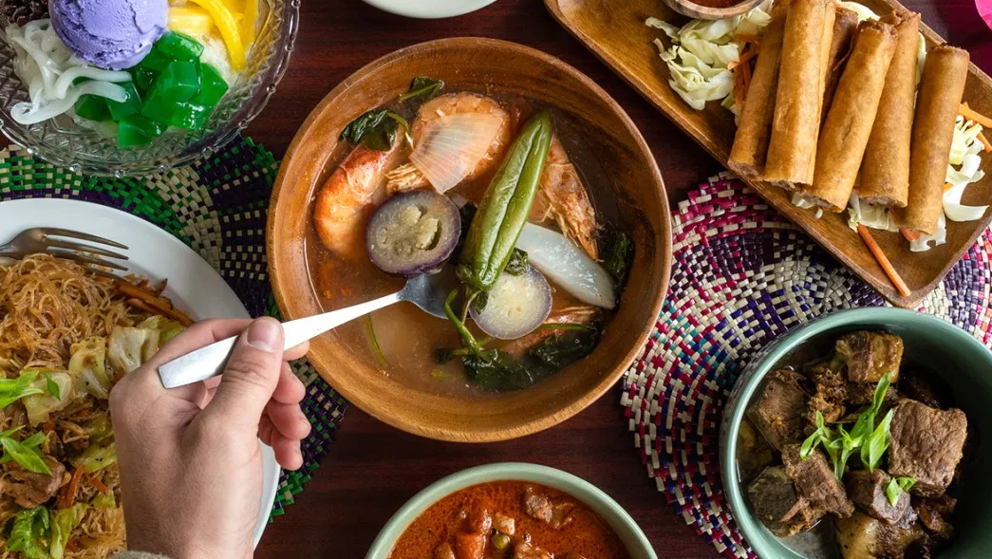
THE TASTE OF HOME AWAY FROM HOME
CAPSTONE PROJECT
ANDREEA STANESCU

Slide 2
TABLE OF CONTENTS
Introduction
Data description
Methodology
Results
Conclusion
1
2
3
4
5
ANDREEA STANESCU

Slide 3
Introduction
This report is for the final course of the Data Science Specialization by IBM on Coursera platform. For this project I am proposing a hypothetical situation of opening a Filipino restaurant in Bucharest.
Context
Bucharest is becoming more and more a target for travelers with over 2 mil tourists in 2019.
With the increase in tourism in Asia, Asian food is becoming more and more popular as cuisine in Europe.
Last but not least, the number of immigrants from Philippines in Romania (especially Bucharest) is increasing each year.
Business Problem
A young cook from Philippine came to Bucharest and he would like to open a restaurant with traditional Filipino cuisine and to host traditional events.
I will try to help him using data science and machine learning algorithms in order to choose optimum location for the restaurant.
Data
Following data will be analyzed:
Bucharest’s Districts repartition
Distribution of Asian Restaurants in Bucharest and clustering in order to identify best location
Data related to immigration rate from Philippine to Romania which will be used as basis for forecasting
ANDREEA STANESCU

